Slide 1
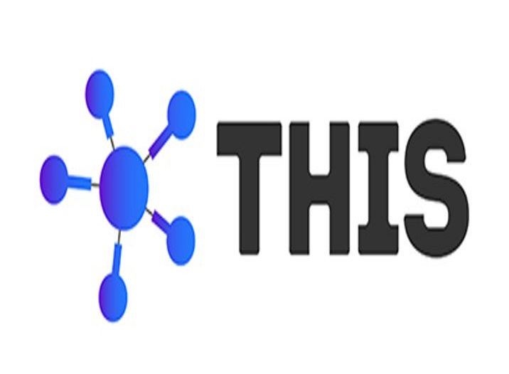
Project Presentation On
Train Ticket Reservation System

Slide 2
PRESENTATION BY GROUP 1
ABHISHEK YADAV
MANJUNATH DURGESH
NITIN KUMAR GAUR
PRATHIBHA VENKATESH
RATHAN PANCHAL
SUSHMA SURESH

Slide 3
OBJECTIVE
The developed application consist registration page where passenger can register and login.
Passenger will be able to get train details.
User will get the passenger details options.
User will get the payment options.
User will get ticket booking confirmation with ticket print.

Slide 4
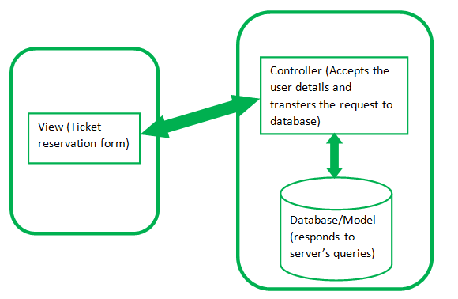
MVC ARCHITECTURE

Slide 5
SOFTWARE TOOLS USED
Spring Web
Spring Boot Dev Tools
Spring Data JPA
Thymeleaf
MariaDB Driver
MySQL

Slide 6
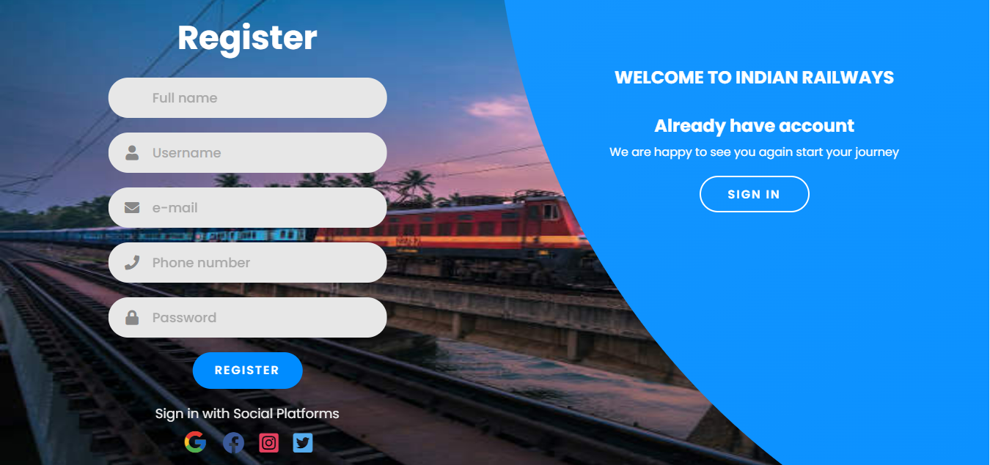
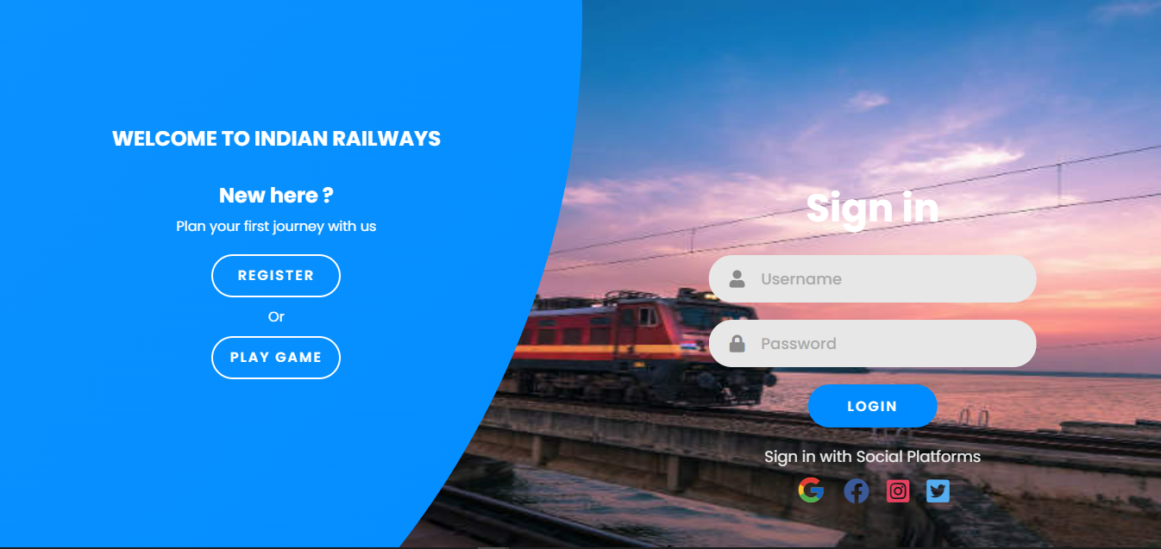
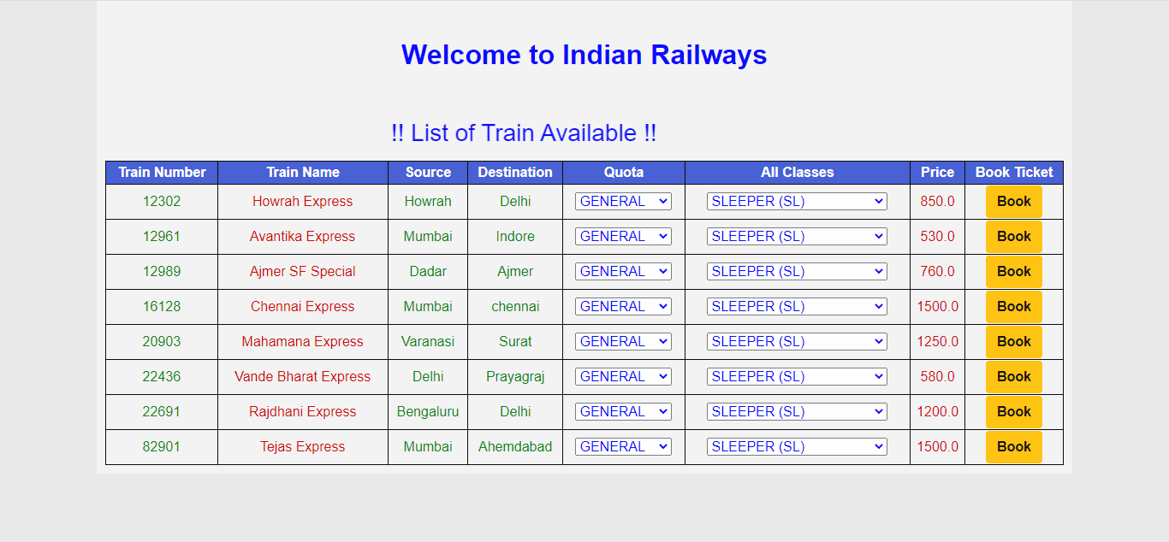
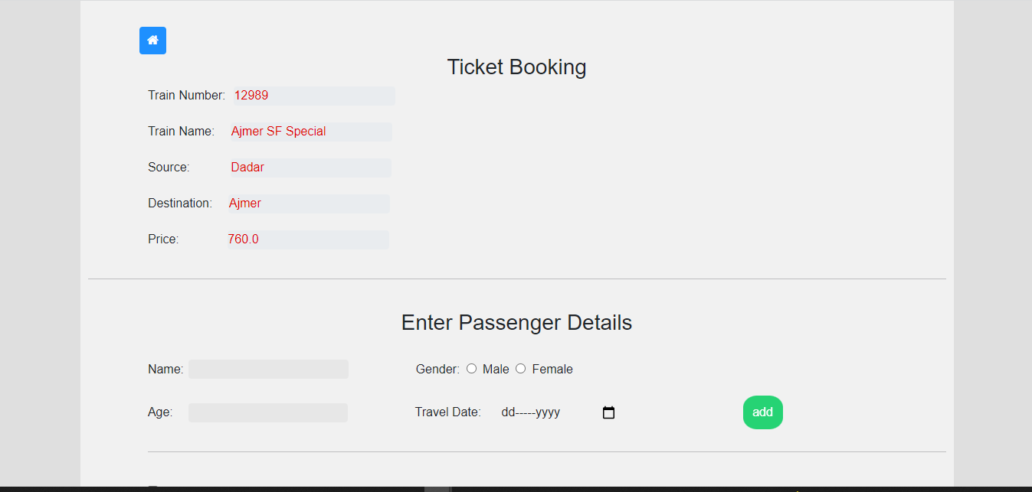
RESULTS

Slide 7
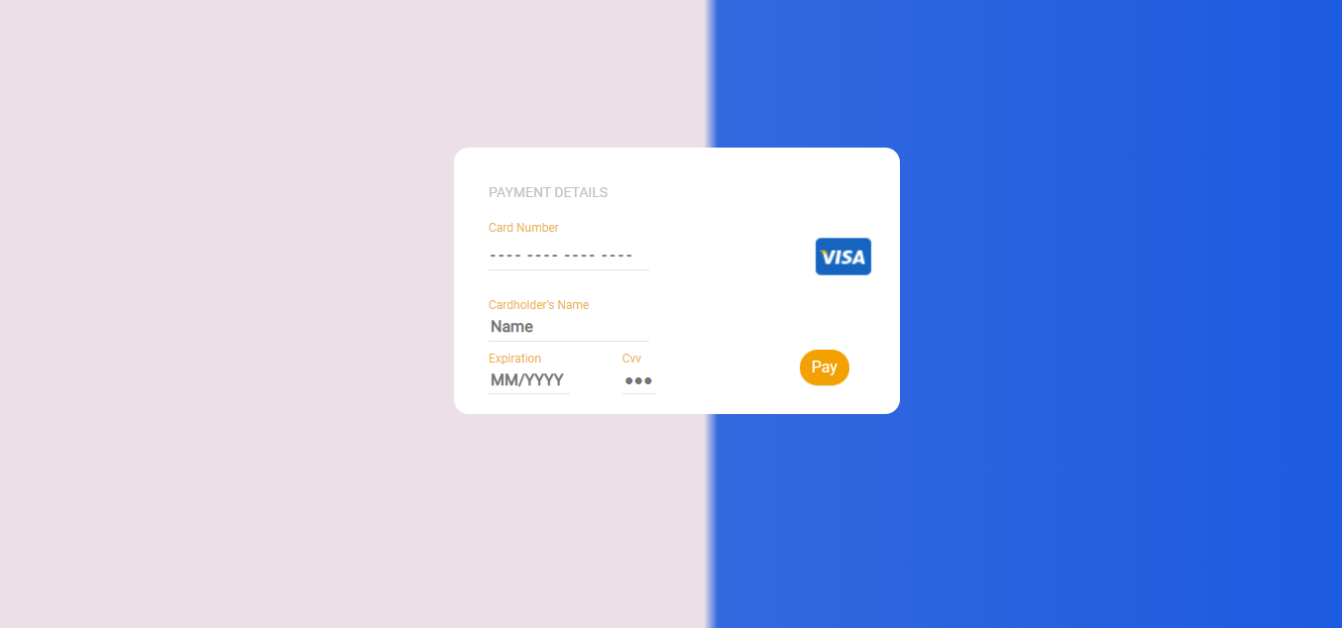
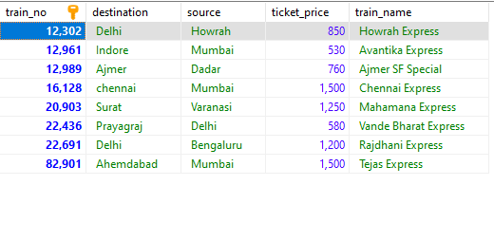
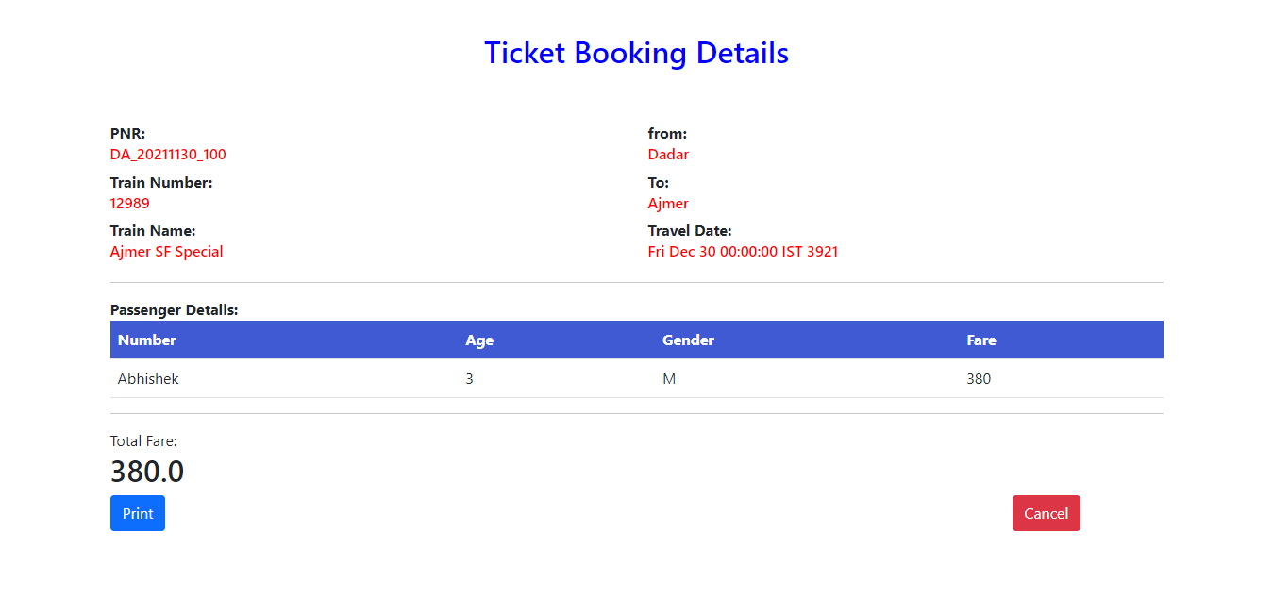
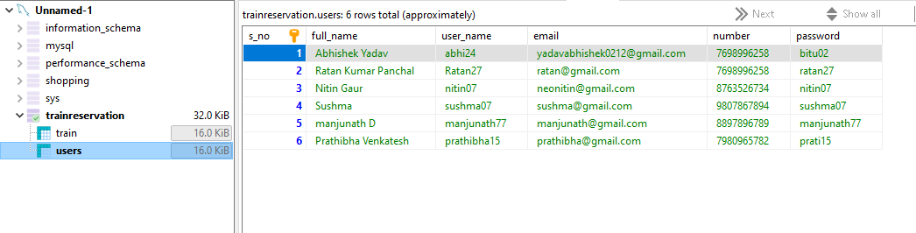

Slide 8
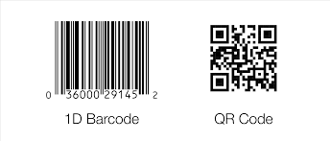

Slide 9
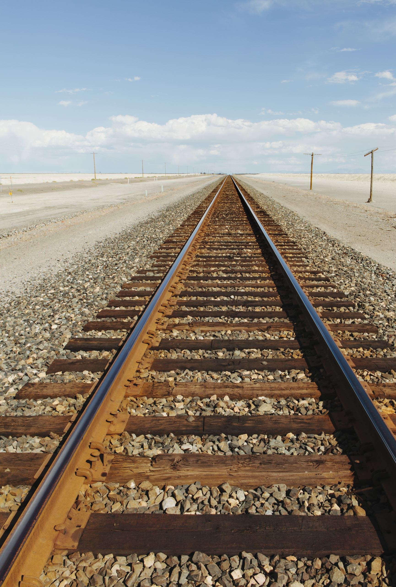
CONCLUSION
The Railway Ticket Reservation System is to Manage the Details of trains like train booking, timetable, ticket fares, station. Also, it manages all the information about passenger details.
The purpose of the project is to build an Application Program to Reduce the manual Work for managing and Booking the trains. As well it will help to avoid the manual errors.

Slide 10
THANK YOU

